Slide 1
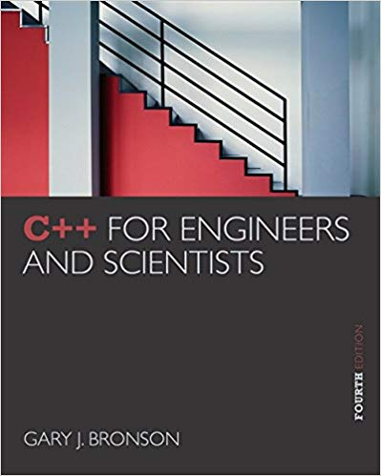
ELEG 1043
Computer Applications in Engineering
C++ for Engineers and Scientists, Fourth Edition
Notes:
1. Not vey new, but good enough for you
2. Not for Computer Science, For engineering

Slide 2
Chapter 1:
Preliminaries
Notes:
Before starting to learn, need to learn some preliminary knowledge
Some parts may be known before.
Necessary for others.

Slide 3
Acknowledgement
Some of the slides or images are from various sources. The copyright of those materials belongs to their original owners.
C++ for Engineers and Scientists, Fourth Edition
Notes:
Don’t distribute the soft copies t others or sell hard copy
Copyright issues

Slide 4
Preliminary Three: Software Development
Computer program: Self-contained set of instructions used to operate a computer to produce a specific result
  Also called software
  Solution developed to solve a particular problem, written in a form that can be executed on a computer
C++ for Engineers and Scientists, Fourth Edition
Notes:
Students often believe that once the program is written, it is done.
A discussion of the software life cycle is helpful.

Slide 5
Preliminary Four: Algorithms
Algorithm: Step-by-step sequence of instructions
  Must terminate
  Describes how the data is to be processed to produce the desired output
Formula: Mathematical equations
Flowchart: Diagrams with symbols
C++ for Engineers and Scientists, Fourth Edition
Notes:
Before a program is written, the programmer must clearly understand what data is to be used, the desired result, and the procedure used to produce this result.
It describes how the data is to be processed to produce the desired outputs.
Programming is the translation of a selected algorithm into a language the computer can use.

Slide 6
Software, Hardware, and Computer Storage
Programming: Process of writing a program, or software
Programming language:
  Set of instructions used to construct a program
  Comes in a variety of forms and types
C++ for Engineers and Scientists, Fourth Edition
Notes:
Low-level language : machine language
High-level language : C++, Python

Slide 7
Application and System Software
Application software: Programs written to perform particular tasks for users
System software: Collection of programs to operate the computer system
  System software must be loaded first; called booting the system
C++ for Engineers and Scientists, Fourth Edition
Notes:
Compare application software and system software, and explain the bootstrap loader and the concept of booting the system.
Introduce operating systems and the concepts of multiuser, multitasking, and multiprogramming as they relate to operating systems.

Slide 8
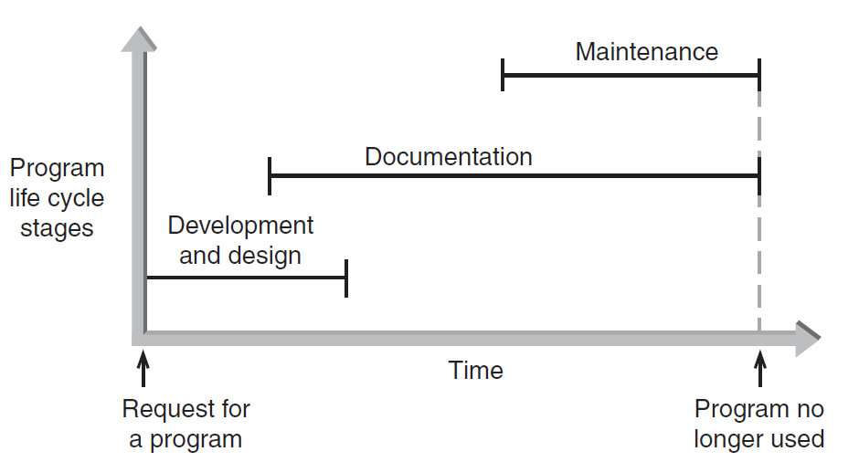
Preliminary Three: Software Development (continued)
Figure 1.2 The three phases of program development
C++ for Engineers and Scientists, Fourth Edition
Notes:
consists of three overlapping phases
Although the documentation phase is described as occurring after the software has been written, a great deal of documentation is actually developed during the analysis phase.
Functional specifications provide details of what the software must do.
System specifications describe the architecture of the software.

Slide 9
Phase I: Development and Design
Program requirement: Request for a program or a statement of a problem
After a program requirement is received, Phase I begins:
Phase I consists of four steps:
  Analysis
  Design
  Coding
  Testing
C++ for Engineers and Scientists, Fourth Edition
Notes:
Phase I begins with a statement of a problem or a specific request for a program, which is referred to as a program requirement.
Breaking the complex problem into many simple problems

Slide 10
A Case Study: Radar Speed Trap
Step 1: Analyze the Problem
  Understand the desired outputs
  Determine the required inputs
Step 2: Develop a Solution
  Determine the algorithms to be used
  Use top-down approach to design
Step 3: Code the Solution
Step 4: Test and Correct the Program
C++ for Engineers and Scientists, Fourth Edition

Slide 11
A Case Study: Radar Speed Trap (continued)‏
Analyze the Problem
  Output: Speed of the car
  Inputs: Emitted frequency and received frequency
Develop a Solution
  Algorithm:
    Assign values to f0 and f1
    Calculate and display speed
C++ for Engineers and Scientists, Fourth Edition

Slide 12
Computer Storage
Bit: Smallest unit of data; value of 0 or 1
Byte: Grouping of 8 bits representing a single character
Character codes: Collection of patterns of 0s and 1s representing characters
C++ for Engineers and Scientists, Fourth Edition

Slide 13
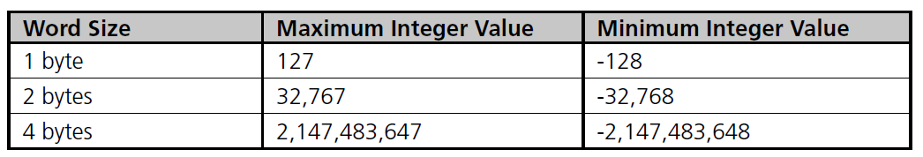
Computer Storage (continued)‏
Word: Grouping of one or more bytes
  Facilitates faster and more extensive data access
Number of bytes in a word determines the maximum and minimum values that can be stored:
Table 1.4 Word size and Integer Values
C++ for Engineers and Scientists, Fourth Edition

Slide 14
Chapter 2:
Problem Solving Using C++

Slide 15
Objectives
In this chapter, you will learn about:
Modular programs
Programming style
Data types
Arithmetic operations
Variables and declaration statements
Common programming errors
C++ for Engineers and Scientists, Fourth Edition

Slide 16
Introduction to C++
Modular program: A program consisting of interrelated segments (or modules) arranged in a logical and understandable form
  Easy to develop, correct, and modify
Modules in C++ can be classes or functions
C++ for Engineers and Scientists, Fourth Edition

Slide 17
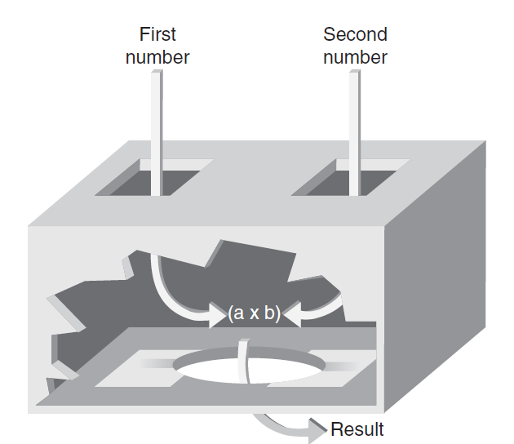

Introduction to C++ (continued)‏
Function: Accepts an input, processes the input, and produces an output
  A function’s processing is encapsulated and hidden within the function
C++ for Engineers and Scientists, Fourth Edition

Slide 18
Introduction to C++ (continued)‏
Class: Contains both data and functions used to manipulate the data
Identifier: A name given to an element of the language, such as a class or function
  Rules for forming identifier names:
    First character must be a letter or underscore
    Only letters, digits, or underscores may follow the initial letter (no blanks allowed)‏
    Keywords cannot be used as identifiers
    Maximum length of an identifier = 1024 characters
C++ for Engineers and Scientists, Fourth Edition

Slide 19
Introduction to C++ (continued)‏
Examples of valid C++ identifiers:
  degToRad intersect addNums
  slope bessell multTwo
  findMax density
Examples of invalid C++ identifiers:
  1AB3 (begins with a number)‏
  E*6 (contains a special character)‏
  while (this is a keyword)‏
C++ for Engineers and Scientists, Fourth Edition

Slide 20
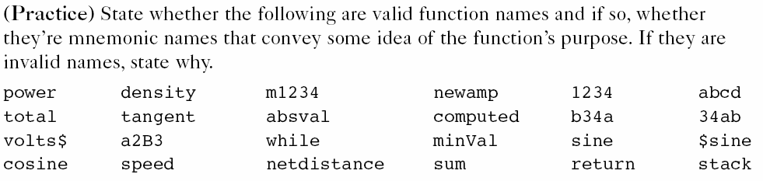
Homework Assignment 1
Question 1 in the Exercises 2.1 on the page 53
tmp_ft
C++ for Engineers and Scientists, Fourth Edition
Notes:
Don’t distribute the soft copies t others or sell hard copy
Copyright issues

Slide 21
Comments
Comments: Explanatory remarks in the source code added by the programmer
Line comment: Begins with // and continues to the end of the line
    Example: // this program displays a message
        #include <iostream>
        using namespace std;
        int main ()
        {
        cout << “Hello there world!”; //displays text
        return 0;
        }
C++ for Engineers and Scientists, Fourth Edition

Slide 22
Comments (continued)‏
Block comments: comments that span across two or more lines
  Begin with /* and end with */
  Example:
  /* This is a block comment that
  spans
  across three lines */
C++ for Engineers and Scientists, Fourth Edition

Slide 23
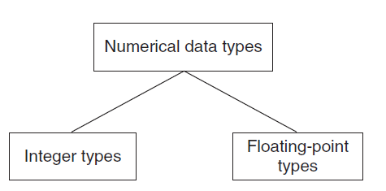
Data Types
Data type: A set of values and the operations that can be applied to these values
Two fundamental C++ data groupings:
  Class data type (a class): Created by the programmer
  Built-in data type (primitive type): Part of the C++ compiler
Figure 2.5 Built-in data types
C++ for Engineers and Scientists, Fourth Edition

Slide 24
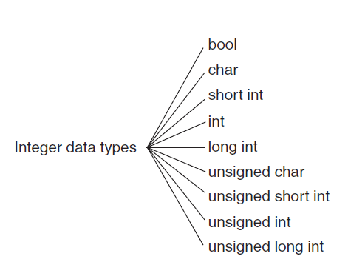
Integer Data Types
Figure 2.6 C++ integer data types
C++ for Engineers and Scientists, Fourth Edition

Slide 25
Floating-Point Types
Floating-point number (real number): Zero or any positive or negative number containing a decimal point
  Examples: +10.625, 5.0, -6.2
  Three floating-point data types in C++:
    float (single precision)‏
    double (double precision)‏
    long double
C++ for Engineers and Scientists, Fourth Edition

Slide 26
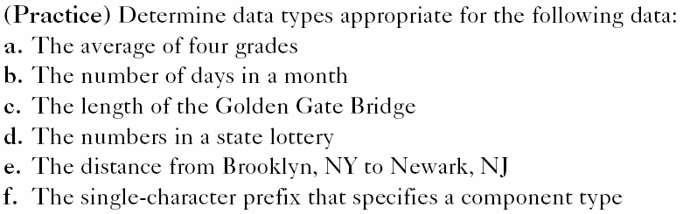
Data Types
C++ for Engineers and Scientists, Fourth Edition

Slide 27
Signed and Unsigned Data Types
Signed data type: One that permits negative, positive, and zero values
Unsigned data type: Permits only positive and zero values
  An unsigned data type provides essentially double the range of its signed counterpart
C++ for Engineers and Scientists, Fourth Edition

Slide 28
Signed and Unsigned Data Types
Maximum Value and Minimum Value with the following number of bytes for Signed Data Type
  1 byte
  2 bytes
  4 bytes
How about Unsigned Data Type?
C++ for Engineers and Scientists, Fourth Edition

Slide 29
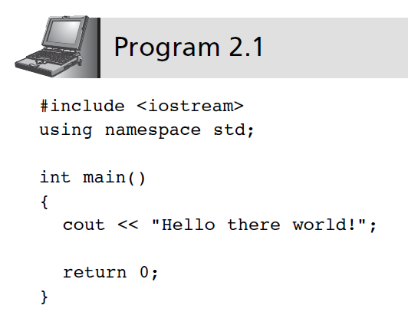
The cout Object
cout object: An output object that sends data to a standard output display device
C++ for Engineers and Scientists, Fourth Edition

Slide 30
Chapter 3:
Assignment, Formatting, and Interactive Input

Slide 31
Objectives
In this chapter, you will learn about:
Assignment operations
Formatting numbers for program output
Using mathematical library functions
Program input using the cin object
Symbolic constants
A case study involving acid rain
Common programming errors
C++ for Engineers and Scientists, Fourth Edition

Slide 32
Objectives
In this chapter, you will learn about:
Assignment operations
Formatting numbers for program output
Using mathematical library functions
Program input using the cin object
Symbolic constants
A case study involving acid rain
Common programming errors
C++ for Engineers and Scientists, Fourth Edition

Slide 33
Assignment Operations
Assignment Statement: Assigns the value of the expression on the right side of the = to the variable on the left side of the =
  int a = 2;
  left right
Another assignment statement using the same variable will overwrite the previous value with the new value
Examples:
slope = 3.7;
slope = 6.28; (Overwrite)
C++ for Engineers and Scientists, Fourth Edition

Slide 34
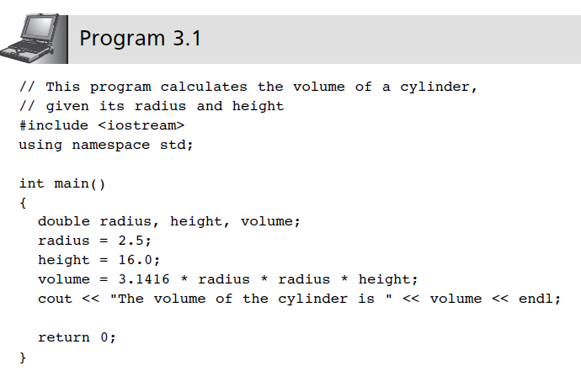
Assignment Operations (continued)
C++ for Engineers and Scientists, Fourth Edition

Slide 35
Assignment Operations (continued)
Additional assignment operators provide short cuts: +=, -=, *=, /=, %=
  Example:
  sum = sum + 10;
  is equivalent to: sum += 10;
  price *= rate +1;
  is equivalent to:
  price = price * (rate + 1);
C++ for Engineers and Scientists, Fourth Edition

Slide 36
Assignment Operations (continued)
Increment operator ++: Unary operator for the special case when a variable is increased by 1
Prefix increment operator appears before the variable
  Example: ++i
Postfix increment operator appears after the variable
  Example: i++
C++ for Engineers and Scientists, Fourth Edition

Slide 37
Assignment Operations (continued)
Example: k = ++n; //prefix increment
is equivalent to:
n = n + 1; //increment n first
k = n; //assign n’s value to k
Example: k = n++; //postfix increment
is equivalent to
k = n; //assign n’s value to k
n = n + 1; //and then increment n
C++ for Engineers and Scientists, Fourth Edition

Slide 38
Assignment Operations (continued)
Decrement operator --: Unary operator for the special case when a variable is decreased by 1
Prefix decrement operator appears before the variable
  Example: --i;
Postfix decrement operator appears after the variable
  Example: i--;
C++ for Engineers and Scientists, Fourth Edition

